Slide 1

Chapter 13:
Introduction to Classes

Slide 2
13.1
Procedural and Object-Oriented Programming

Slide 3

Procedural and Object-Oriented Programming
Procedural programming focuses on the process/actions that occur in a program
Object-Oriented programming is based on the data and the functions that operate on it. Objects are instances of (abstract data types) ADTs that represent the data and its functions

Slide 4
Limitations of Procedural Programming
If the data structures change, many functions must also be changed
Programs that are based on complex function hierarchies are:
  difficult to understand and maintain
  difficult to modify and extend
  easy to break

Slide 5
Object-Oriented Programming
Terminology
class: like a struct (allows bundling of related variables), but variables and functions in the class can have different properties than in a struct see: http://www.learncpp.com/cpp-tutorial/47-structs/
object: an instance of a class, in the same way that a variable can be an instance of a struct

Slide 6
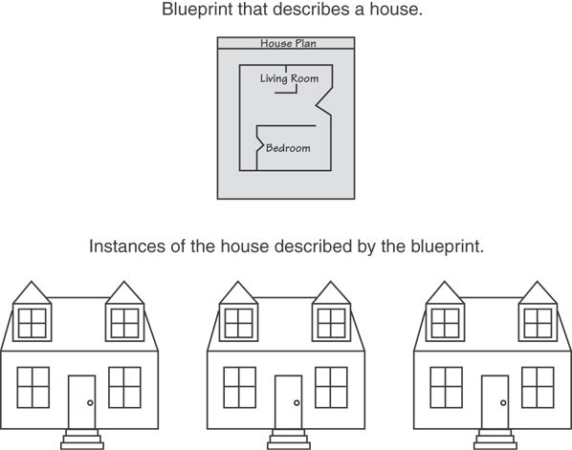
Classes and Objects
A Class is like a blueprint and objects are like houses built from the blueprint

Slide 7
Object-Oriented Programming
Terminology
attributes: members of a class
methods or behaviors: member functions of a class

Slide 8
More on Objects
data hiding: restricting access to certain members of an object
public interface: members of an object that are available outside of the object. This allows the object to provide access to some data and functions without sharing its internal details and design, and provides some protection from data corruption

Slide 9
13.2
Introduction to Classes

Slide 10
Introduction to Classes
Objects are created from a class
Format:
  class ClassName
  {
  declaration;
  declaration;
  };

Slide 11
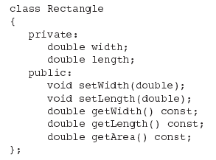
Class Example

Slide 12
Access Specifiers
Used to control access to members of the class
public: can be accessed by functions outside of the class
private: can only be called by or accessed by functions that are members of the class

Slide 13
Class Example
Private Members
Public Members

Slide 14
More on Access Specifiers
Can be listed in any order in a class
Can appear multiple times in a class
If not specified, the default is private

Slide 15

Using const With Member Functions
const appearing after the parentheses in a member function declaration specifies that the function will not change any data in the calling object.

Slide 16
Defining a Member Function
When defining a member function:
  Put prototype in class declaration
  Define function using class name and scope resolution operator (::)
    int Rectangle::setWidth(double w)
    {
    width = w;
    }

Slide 17
Accessors and Mutators
Mutator: a member function that stores a value in a private member variable, or changes its value in some way
Accessor: function that retrieves a value from a private member variable. Accessors do not change an object's data, so they should be marked const.

Slide 18
13.3
Defining an Instance of a Class

Slide 19
Defining an Instance of a Class
An object is an instance of a class
Defined like structure variables:
  Rectangle r;
Access members using dot operator:
  r.setWidth(5.2);
  cout << r.getWidth();
Compiler error if attempt to access private member using dot operator

Slide 20
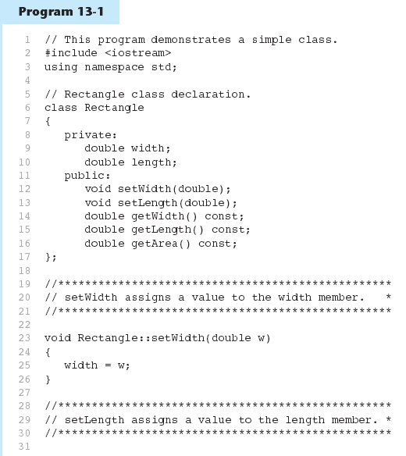

Slide 21
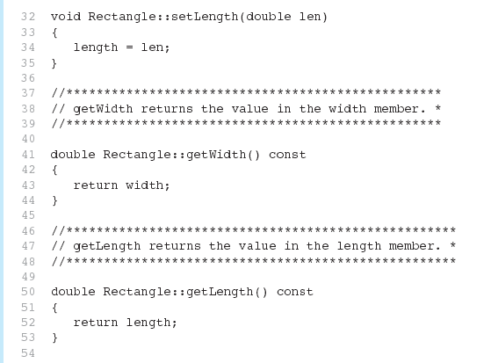
Program 13-1 (Continued)

Slide 22
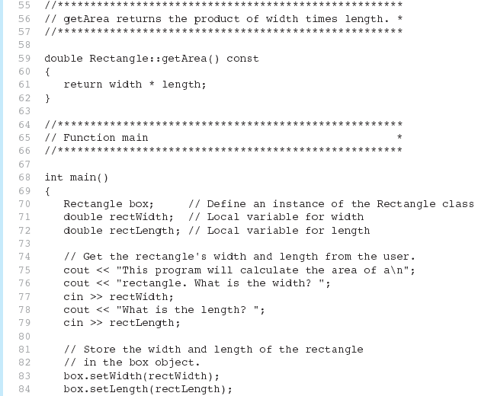
Program 13-1 (Continued)

Slide 23
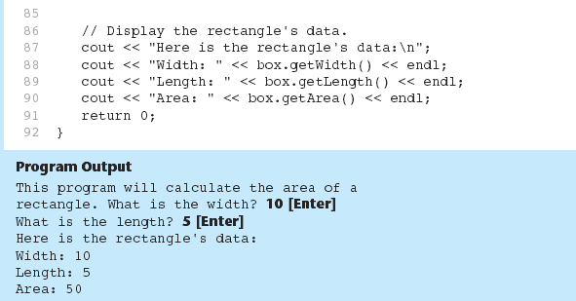
Program 13-1 (Continued)

Slide 24
13.4
Why Have Private Members?

Slide 25
Why Have Private Members?
Making data members private provides data protection
Data can be accessed only through public functions
Public functions define the class’s public interface

Slide 26

Code outside the class must use the class's public member functions to interact with the object.

Slide 27
13.16
The Unified Modeling Language

Slide 28
The Unified Modeling Language
UML stands for Unified Modeling Language.
The UML provides a set of standard diagrams for graphically depicting object-oriented systems

Slide 29
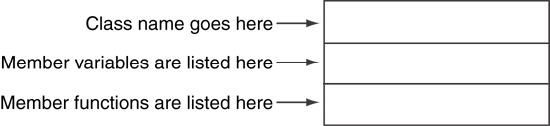
UML Class Diagram
A UML diagram for a class has three main sections.

Slide 30
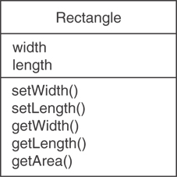
Example: A Rectangle Class
class Rectangle
{
private:
double width;
double length;
public:
bool setWidth(double);
bool setLength(double);
double getWidth() const;
double getLength() const;
double getArea() const;
};

Slide 31
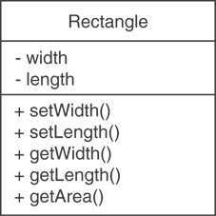
UML Access Specification Notation
In UML you indicate a private member with a minus (-) and a public member with a plus(+).
These member variables are private.
These member functions are public.

Slide 32
UML Data Type Notation
To indicate the data type of a member variable, place a colon followed by the name of the data type after the name of the variable.
- width : double
- length : double

Slide 33
UML Parameter Type Notation
To indicate the data type of a function’s parameter variable, place a colon followed by the name of the data type after the name of the variable.
+ setWidth(w : double)

Slide 34
UML Function Return Type Notation
To indicate the data type of a function’s return value, place a colon followed by the name of the data type after the function’s parameter list.
+ setWidth(w : double) : void

Slide 35
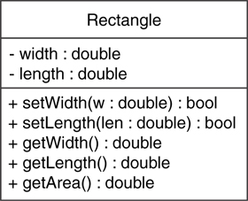
The Rectangle Class

